Slide 1
Classroom
Assessment
Techniques
Amanda Albert, Chelsea Stripling, & Sarah Helson
Atlanta Area Bibliographic Group Conference
June 20, 2014
Notes:
Hello everyone – we would like to welcome you to Session 2 of the conference!
My name is Amanda Albert
My name is Chelsea S.
My name is Sarah Helson
and we are presenting to you today about Classroom Assessment Techniques.
We are recent MSLIS graduates of Syracuse University and this presentation came out of a class we completed Fall 2013.
This class was taught by Dr. Megan Oakleaf and focused on Instructional Strategies for Information Professionals.
During this course, we were on both sides of the fence:
We both participated in many CATs to support our own learning, and we were able to use CATs in our own instruction
I think all of us can attest to how valuable they were in our course work.
We realized how important assessment is to student learning, and we have come to believe that it is the heart of learning itself.
Today we want to share with you just how easy it can be by using classroom assessment techniques, and how your students’ learning can be transformed.

Slide 2
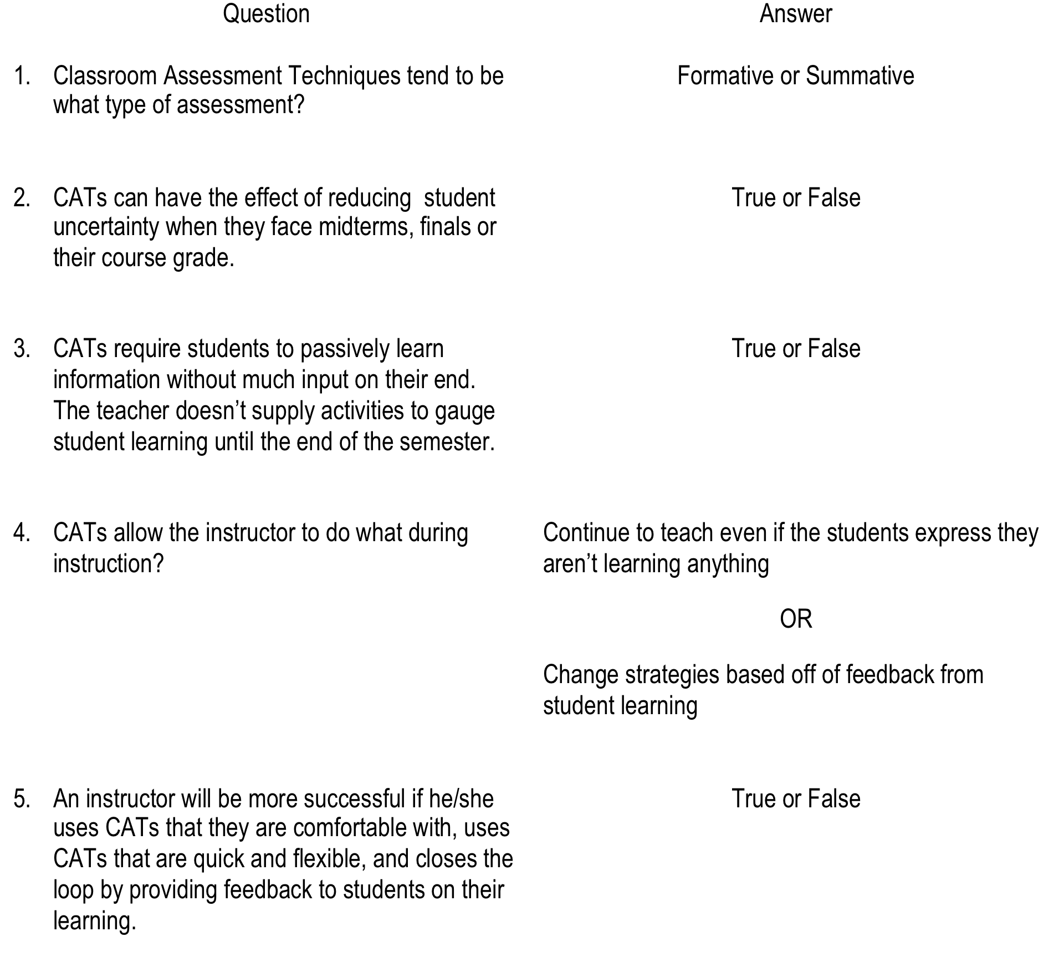
Pop Quiz! Circle the answer you think is best.
Notes:
Before we begin, we would like everyone to complete this short questionnaire just to gauge you knowledge of CATs.
We’ll give you a couple of minutes to look it over and complete, then we will go over the answers.
Here are the answers – don’t worry if you didn’t get 100%! We will explain more throughout the presentation!
SHOULD WE WRITE THESE DOWN ON A WHITE BOARD IF AVAILABLE? I CREATED A SLIDE WITH ANSWERS --- TO KEEP OR NOT TO KEEP??
----- Meeting Notes (6/17/14 21:46) -----
Wait one minute to see where people are, then click slide to reveal answers.

Slide 3
Background Knowledge Probe
Please complete the following multiple choice questionnaire.
Designed to assess
Prior knowledge on the subject
Baseline knowledge level
When is it used?
Beginning of a course
Beginning of class
Introducing a new lesson
Prior to introducing a new topic
Notes:
What you just completed was something known as a Background Knowledge Probe:
Assesses student’s knowledge on a subject before it is taught
And familiarize themselves what they are about to learn
Gives the instructor a foundation from which to build
And helps narrow down content to be taught so that he or she is not teaching students what they already know
The instructor can also make connections between prior knowledge of the subject and new info being introduced that session.
CATs can be adaptable and simple as our example was not very long or difficult.
We will also use this CAT and compare it to another assessment at the end of the class to see what you learned from our instruction today.
As you will see, you can use more than one CAT per class.
Doing so is helpful because the instructor then has evidence of students’ progress throughout the class to compare
Something that you can do in your instruction as an informal pre/post test.

Slide 4
Agenda
What are CATs?
Various types of CATs and how to use them in your classroom
CAT demonstrations
Takeaways & Recommended Literature
Conclusion: CAT experts!
Notes:
Today we are going to discuss CATs and the variety of techniques that can be used to assess student learning in the classroom.
We will discuss why they are valuable, and which techniques assess different types of learning.
We will also continue to demonstrate various CATs throughout the presentation, and at the end you will leave with some takeaways about what we talked about, and you will all be CAT experts!
Also during the presentation, please feel free to ask questions at anytime - and we will have some time for discussion at the end about how you might be able to use CATs in your own work.

Slide 5
What is a CAT?
In class, informal, formative assessment
Measures & reinforces student learning
Empowering!
Creates independent learners
Requires a dedication to teaching & motivation to improve
Notes:
What is a CAT?
Designed to help instructors measure what students are learning in class
And how well they are learning the content
Goal: empower both the instructor and the student to improve the quality of teaching and learning in the classroom.
CATs reinforce student learning:
By focusing student attention on the most important elements of the course, or instruction session;
By providing additional practice for students in learning and thinking skills,
Training students to become self-aware, self-assessing, and independent learners.
CATs do not require:
Specialized or formal training of the instructor.
informal techniques used to inform and improve teaching.
Instructors only need to have a detailed knowledge of the discipline, a dedication to teaching and the motivation to improve.

Slide 6
Direct your teaching:
What are the essential skills and knowledge I am trying to teach?
How can I find out whether students are learning them?
How can I help students learn better?
Learner-Centered; Teacher Directed
Notes:
Classroom assessment techniques are learner centered, and teacher directed, thus focusing on what the student is learning not how the instructor is teaching.
The instructor can sharpen the focus of the instruction session specifically on student learning by asking three questions:
What are the essential skills and knowledge I am trying to teach?
How can I find out whether students are learning them?
How can I help students learn better?
Asking these questions allows you to direct what you are assessing, how you are assessing, and what you do with that information once you have it.
Really this comes down to creating student learning outcomes for an instruction session, or defining what you want you students to be able to do after the session.
Then you can decide the appropriate classroom assessment technique based on your goals for the class.
For example, if you want students to be able to describe how they will use a searching technique after this class, you can have them fill out an application card to assess application of the skills they learned.

Slide 7
Student
Teacher
Classroom Success
Mutually Beneficial; Context Specific
Notes:
Mutually beneficial assessment technique because it allows students to practice what they are learning before a summative assessment is given
They typically are designed to not cause anxiety because most CATs are anonymous and ungraded, which also has the effect of refocusing the student on learning a concept instead of just making the grade
This also demonstrates that the teacher is actually interested in their learning, and not just giving them a grade
Teachers benefit by being able to reevaluate their teaching in real-time based off assessment evidence in order to better engage and help students learn, thus improving their teaching skills.
Teachers can use this information to help the students succeed in the immediate classroom and when given summative assessments later on.
Each classroom presents:
Different students
Class dynamics
environmental factors can influence the class culture.
Can choose a CAT based on the context of the classroom to better fit the students you are teaching.
Tailoring an assessment also gives better feedback to the instructor on specific learning gaps
So, it is a little bit more work upfront for the instructor, but it will save time, especially in something like a one-shot instruction session.
For example, because you used a CAT at the beginning of class, you might see that the students already know how to cite using MLA and are really bored with the topic, so you can move on to talk about an important copyright issue instead.

Slide 8
Instruction
Administer CAT
Provide Feedback
Feedback Loop
Ongoing; Rooted in good teaching practice
Notes:
As we all know assessment is an ongoing process, and classroom assessment is no different.
Using CATs allows the instructor to create a “feedback loop” within the classroom
Instruction happens
An assessment is administered
Feedback is provided
And the cycle repeats
By consistently closing the loop
Assessment is integrated into the classroom
Communication about learning between instructor and student becomes more efficient and effective
For example, the instructor can address the specific points the students found confusing, and then informs the class as to how they will be modifying the lesson to implement the feedback from the given assessment
Finally, this type of assessment is already rooted in teaching practices
Taken to a whole other level by making assessment
Systematic
Flexible
More effective.
Instead of working from memory about student responses to learning, a CAT can provide concrete evidenced based on a student questionnaire, concept mapping on the white board, or other CAT products
Students take responsibility for their learning by teaching them self-assessment techniques, which allows them to become better skilled at thinking about their own thinking and learning.
They will become better learners both in and out of the classroom because they will have the skills to assess what they are doing and adjust accordingly.

Slide 9
Prior Knowledge, Recall, & Understanding
Background Knowledge Probe
Focused Listing
Misconception/Preconception Check
Empty Outline
Memory Matrix
Minute Paper
Muddiest Point
- Angelo, T.A. & Cross, K.P., 1993, p. 119.
Notes:
So now that we understand what classroom assessment techniques are, lets talk about a the different types of CATs and what they assess. On these slides we will list the “category” of techniques and a few examples.
As we saw with the background knowledge probe at the beginning of this presentation, these techniques can be used at the beginning of class or at the end to assess student prior learning, how well they learned the material presented in class, or something that is still confusing to them. Before instruction even begins the instructor can gain knowledge about where the class stands in relation to the assessed concept, and thus an adjust where he or she will begin instruction. During the session, the instructor can use this data to see what is and is not working, and adjust teaching strategy based off of this information. Giving an assessment at the end of class helps to reinforce concepts discussed during the session and uncovers other gaps in learning, allowing the instructor to adjust to the curriculum before these gaps become impediments to further learning.
To give you more practice with this type of assessment, we are passing out an empty outline for you to fill out as we discuss the other assessment techniques. Students can use the empty outline to organize and learn class concepts. It allows the instructor to find out how well students have recognized the important points of a lecture, reading or presentation; and allows students to recall and organize the main point of a lesson, increasing retention and understanding.

Slide 10
Synthesis & Creative Thinking; Application and Performance
Synthesis & Creative Thinking
Concept Maps
One Sentence Summary
Word Journal
Approximate Analogies
Invented Dialogs
Annotated Portfolios
- Angelo, T.A. & Cross, K.P., 1993, p. 181.
Application and Performance
Directed Paraphrasing
Application Cards
Student-Generated Test Questions
Class Modeling
Paper or Project Prospectus
- Angelo, T.A. & Cross, K.P., 1993, p. 231
Notes:
The Synthesis and Creative thinking category of assessment looks at how students can organize and synthesize and connect large pieces of information. It requires students to make connections between new information and concepts they may know. It allows students to creatively think of concise solutions to new problems. These techniques allow students to create an original, intellectual product, and gives the instructor the opportunity to assess these products that are a result of synthesis of the class content and students’ intelligence, judgment, knowledge and skills.
The instructor is able to assess what the students are picking up on during instruction, how they are filling in the blanks, and how they are applying their learning to in class activities and projects and also to real world situations when using Application and Performance assessment techniques. These CATs encourage students to demonstrate what they know and how well they know it. For example, Application Cards emphasize transferable skills as they prompt students to think about how they can apply the knowledge they gained in class to a problem they are having outside of the classroom.

Slide 11
Analysis & Critical Thinking; Assessing Learner Attitudes, Values, & Self Awareness
Analysis and Critical Thinking
Pro-Con Grid
Defining Features Matrix
Categorizing Grid
Analytic Memos
Content, Form, and Function Outlines
- Angelo, T.A. & Cross, K.P., 1993, p. 159.
Learner Attitudes, Values, & Self Awareness
Classroom Opinion Polls
Course-Related Confidence Surveys
Interests/Knowledge/Skills Checklists
Self-Assessment Ways of Learning
Process Analysis
Diagnostic Learning Logs
Teacher-Designed Feedback forms
Assignment Assessments
- Angelo, T.A. & Cross, K.P., 1993, p. 257, 299, 320, 343
Notes:
The analysis and critical thinking category allows the instructor to assess student analysis of the material taught in class. The instructor observes how students approach problems, how they use their learning to decide how to solve a problem. The instructor can also assess student reactions to the instruction session, material taught in class, and the instructor’s teaching techniques. By using CATs that allow the students to evaluate their own learning, students are active participants in the classroom. According to Angelo and Cross in their book Classroom Assessment Techniques, the more students are engaged and aware of their own learning skills, performance, and habits, the greater their satisfaction will be with their learning, and the more likely they will become life-long learners. We see this as the ultimate goal of library instruction, and the most important piece of classroom assessment.
What questions are there about anything that we have discussed so far? Anyone who doesn’t have a complete outline can ask questions now or after the session!

Slide 12
Think-Pair-Share Group Activity
Fill out the form.
Think about how you would use CATs in your instruction.
Share with a partner!
Notes:
To give you all time to reflect and synthesize what we’ve just learned, we’re going to implement another CAT!
Right now we are passing around a handout for you to keep. This handout lists some CATs that we discussed today, and some that we believe are particularly useful for information literacy instruction, along with brief descriptions.
You’ll use these handouts and your new knowledge to complete a CAT called Think-Pair-Share. T-P-S, like all CATs, is a flexible activity that can be adapted to any classroom situation, but it’s one of my favorites because it encourages self-reflection and group interaction.
You’ll start by contemplating, on your own, some specific ways you can use CATs in your own instruction. Refer to the handout for CAT ideas.
After a few minutes, I’ll prompt you to pair up with the person sitting next to you. Share your ideas for using CATs with eachother, then brainstorm a few pros and cons of CATs as an overall tool based on what we’ve discussed today.
After that, we’ll call on some pairs to share their ideas and discuss the pros and cons as a large group.
We’ll give you about 7-8 minutes to complete the T-P-S, and you can get started now!
GROUP DISCUSSION IF THERE IS TIME???

Slide 13
Recommended Literature
Angelo, T.K., & Cross, K.P. (1993). Classroom assessment techniques: A handbook for college teachers. San Francisco, CA: Jossy-Bass.
Simpson-Beck, V. (2011). Assessing classroom assessment techniques. Active Learning in Higher Education, 12(2), 125-132. DOI: 10.1177/1469787411402482.
Stewart, S. L. (1998). Assessment for library instruction: The Cross/Angelo model. Research Strategies, 16(3), 165-174. DOI: 10.1016/S0734-3310(00)80002-6.
Notes:
Before we close, I wanted to bring your attention to our recommended literature. In preparation for this presentation and in our coursework last Fall, Sarah, Amanda and I read many many articles and books on CATs, and we think these three sources give a great overview of them from different perspectives.
The Angelo and Cross book that Sarah mentioned is really the seminal work! Angelo and Cross created the idea of CATs as a tool, and their book has all you might want or need to know about using CATs.
The Simpson-Beck article is a really interesting article that takes an empirical and quantitative look into whether or not CATs actually affect learning. Her research suggests that CATs do not seem to improve student learning. This is contrary to most literature on CATs that we found, but it seems like a well-researched piece and it is an interesting one to examine while you make your own decisions on CATs and their effectiveness.
This is an old article, but it is an interesting foil to Simpson-Beck’s. Stewart provides a lot of information about the history of CATs, what CATs are, their principles, how they should/could be implemented, etc. Stewart makes a big case for CATs being very effective tools that all librarians should use. But, like Simpson-Beck notes of most CAT literature, Stewart doesn’t really provide any evidence or research showing this is actually the case.
In the end, you’ll have to decide whether you think CATs are helpful tools, or a waste of time; but these three sources could help you make a more informed decision.

Slide 14
So, What Should You Take Away?
What are CATs?
Quick, in-class assessments
Mutually beneficial to student and instructor
Promotes better teaching practices through self-reflection
Know your context/audience:
Know your audince, know your content, and know your method of teaching
CATs are customizable, and are most successful when tailored to your session
Closing the Loop:
Provides feedback to students and instructors in real-time
Students gain an understanding in:
How they are doing in class
Where they can improve
You care about their learning
Notes:
Well here’s where we start wrapping up our presentation, so let’s go over the main concepts that you should take away.
What are CATs?
CATs are flexible, customizable in-class assessment tools that can be used in a nearly any class setting.
CATs are beneficial for both the student and the instructor for a variety of reasons; they allow students to engage with material in a low-risk way and allow instructors to get real-time feedback on students’ learning.
CATs also promote better teaching practices by allowing the instructor to reflect on the student responses to his/her own teaching methods and change methods if need be, even in the middle of a class.
And there are many different types of CATs that can assess different aspects of student learning, as Sarah showed us earlier, so the instructor can choose the kind of CAT that would be the best fit.
When you’re faced with an instruction session, it is most important to know your content, know your student “audience”, and start with solid learning outcomes. Then, consider how you can customize CATs to your lesson plan. CATs work best when they are tailored to a specific session, and as we demonstrated today they are easily integrated into a lesson and can even be fun.
Finally, CATs are a way for instructors to close the feedback loop and fully integrate effective assessment into their instruction. CATs allow students to provide feedback and instructors to receive feedback in real-time, making communication between the instructor and the students more efficient and meaningful. CATs also encourage students to take an active role in their own learning and promote self-reflection, which is the hallmark of a life-long learner.

Slide 15
1 Minute Paper
Please think about the following prompt, and write your reaction on the sticky note we have provided you:
What is the most valuable thing you learned today?
Notes:
Before we are finished with this session, we have one more CAT to complete!
This CAT is called the 1 minute paper.
We are passing out small sticky notes. Use these to answer the question :
What is the most valuable thing you learned today?
We will let you know when the minute is up, and
Please hand them to us when you leave!

Slide 16
Contact us!
Amanda Albert
amandabalbert@gmail.com
Chelsea Stripling
crc09@my.fsu.edu
Sarah Helson
sehelson@syr.edu
THANK YOU!
Notes:
Ok the minute is up, papers are finished!
Thank you so much!
We hope you enjoyed our session!
Please feel free to contact us if you have any questions!

